Slide 1
Translational Synergies in Causal Inference and Reinforcement Learning
MaryLena Bleile, Ph.D

Slide 2
What is the Point of Science?
Generally, we wish to i) understand the world, so that we can ii) make better decisions.
E.g.: Doctors prescribing treatments, engineers building robots, etc.

Slide 3
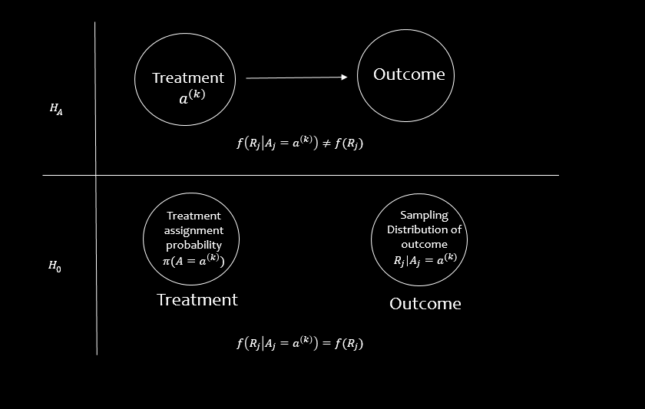
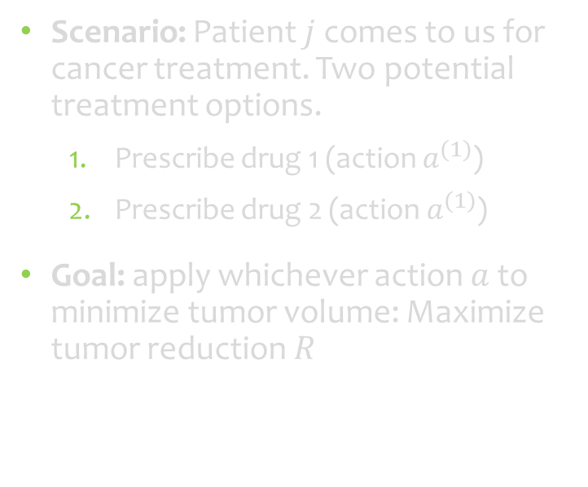


Decision-Making in RL and CI
Reinforcement Learning: “What actions should we take to achieve a specific goal?”
Causal Inference: “What are the fundamental properties and effects of each action?”
Scenario: Patient $j$ comes to us for cancer treatment. Two potential treatment options.
Prescribe drug 1 (action $a^{(1)}$)
Prescribe drug 2 (action $a^{(1)}$)
Goal: apply whichever action $a$ to minimize tumor volume: Maximize tumor reduction $R$
E.g. Randomized Controlled Trial
1
2
$$a^{(1)}$$
$$a^{(2)}$$
Figure 1: Hypothesis tests are foundational on the consideration of counterfactual outcomes.

Slide 4
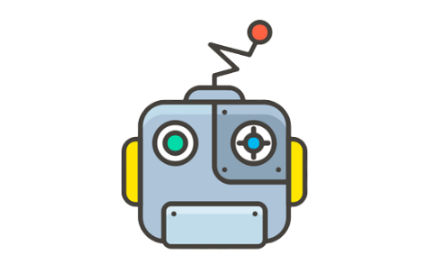





Evaluative Decision-Making
“Agent-Environment Interface”
“Potential Outcomes Framework”
Action-selection policy
Choose treatment 2 next!
$a^{(1)}:$ Apply drug 1
$r |a^{(1)}$ : Tumor volume reduction given drug 1 applied
Treatment Action $a_{j}$
Conditional Rewards
Subject | Action | $$r |a^{(1)}$$ | $$r |a^{(2)}$$ | Causal Effect
Julius | $$a^{(1)}$$ | 20 | ? | ? – 20
Octavian | $$a^{(1)}$$ | 22 | ? | ? - 22
Claudius | $$a^{(2)}$$ | ? | 45 | 45 - ?
Augustus | $$a^{(2)}$$ | ? | 50 | 50 - ?
1
2
3
Potential Outcomes
The tumor shrank by 10mm!
Environment
Incoming patients
“3-armed Bandit”

Slide 5

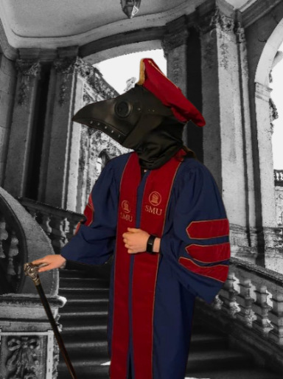
Evaluative Decision-Making
Causal Inference
Discovering fundamental properties of treatments is the goal
Action optimization is offloaded to downstream decision-makers
Reinforcement Learning
Fundamental properties of treatments are important only inasmuch as they affect decision-making
Action optimization is quantified mathematically
Would you give a Ph.D to a plague doctor?
No!
Estimated causal effect was completely wrong (plague doctors thought the masks were “scaring” the disease away)
Yes!
Plague masks were effective at optimizing outcome (preventing the spread of the black death)

Slide 6
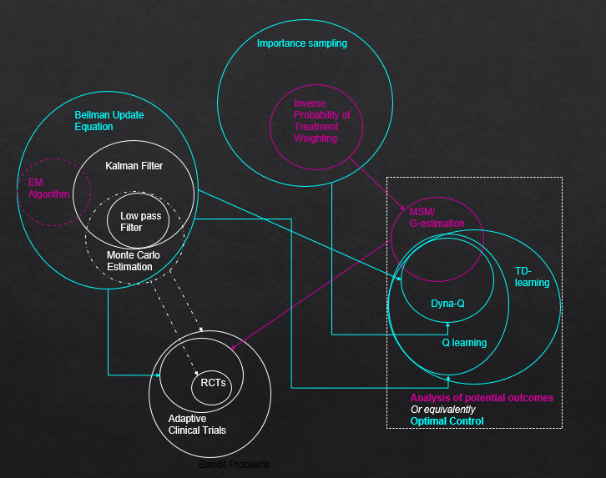
Reinforcement Learning and Causal Inference Share an Intimate Connection
Causal Inference and Reinforcement learning both build models to estimate causal effects in an effort to inform future decisions
Specific techniques share a high degree of overlap, both conceptually and practically

Slide 7
Reinforcement Learning and Causal Inference Share an Intimate Connection
Causal Inference and Reinforcement learning both build models to estimate causal effects in an effort to inform future decisions
Sutton & Barto
TD-learning
Bellman
optimality equations
Burks
Causal diagrams
Shannon
Information Theory
Watkins
Q-learning
Wright
Pathway analysis
Pearl
Causal Inference
Tukey
Rubin
Potential outcomes framework
There was a high degree of shared inspiration and cross-talk between the early establishers of these fields

Slide 8
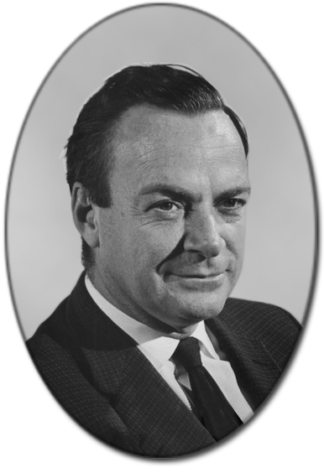
Connection between CI and RL is not widely known
“One of the most dramatic moments in science is when two great fields suddenly come together and are unified”
- Richard Feynmann

Slide 9
Reinforcement Learning and Causal Inference Share an Intimate Connection
Causal Inference and Reinforcement learning both build models to estimate causal effects in an effort to inform future decisions
Specific techniques share a high degree of overlap, both conceptually and practically
This talk’s focus

Slide 10







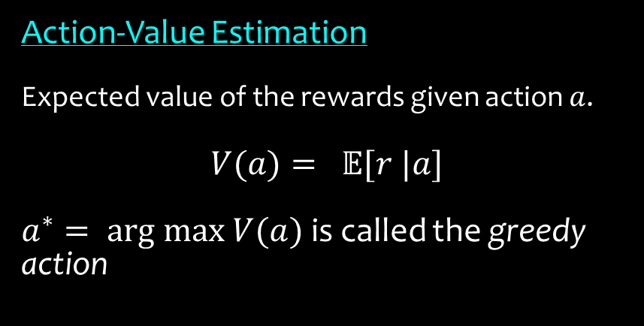
Analysis of Potential Outcomes
Average Treatment Effect (ATE):
Expected value of the causal effects (causal risk differences) across each group.
ATE${(a}^{(1)})=\frac{(?−20)+(?−22)}{2}$
Conditional Average Treatment Effect (CATE):
The same but conditional on covariates X
Action-Value Estimation
Expected value of the rewards given action $a$.
$$V(a)= 𝔼[r |a]$$
$a^{∗}= \text{arg} \text{max} V(a)$ is called the greedy action
Subject (j) | Action | $$r |a^{(1)}$$ | $$r |a^{(2)}$$ | Causal Effect
Julius | $$a^{(1)}$$ | 20 | ? | ? – 20
Octavian | $$a^{(1)}$$ | 22 | ? | ? - 22
Claudius | $$a^{(2)}$$ | ? | 45 | 45 - ?
Augustus | $$a^{(2)}$$ | ? | 50 | 50 - ?
Choose treatment $a_{j}$ next!
Action $a_{j}$
1
2
3
$a^{(1)}:$ Apply drug 1
$r |a^{(1)}$ : Tumor volume reduction given drug 1 applied
Reward $r_{j}$
Environment

Slide 11
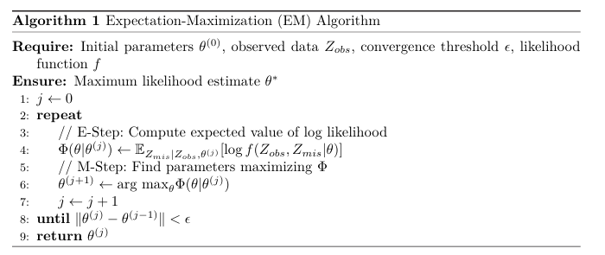
EM Algorithm x Value Iteration
EM Algorithm:
Robust method for imputing missing data
Used widely in statistical applications beyond causal inference
Average Treatment Effect (ATE):
Expected value of the causal effects (causal risk differences) across each group.
ATE${(a}^{(1)})=\frac{(?−20)+(?−22)}{2}$
Conditional Average Treatment Effect (CATE):
The same but conditional on covariates X
Subject (j) | Action | $$r |a^{(1)}$$ | $$r |a^{(2)}$$ | Causal Effect
Julius | $$a^{(1)}$$ | 20 | ? | ? – 20
Octavian | $$a^{(1)}$$ | 22 | ? | ? - 22
Claudius | $$a^{(2)}$$ | ? | 45 | 45 - ?
Augustus | $$a^{(2)}$$ | ? | 50 | 50 - ?
Check what we would expect from the data
Update distribution parameter estimates so that we are less “surprised” by the actual data
$a^{(1)}:$ Apply drug 1
$r |a^{(1)}$ : Tumor volume reduction given drug 1 applied

Slide 12
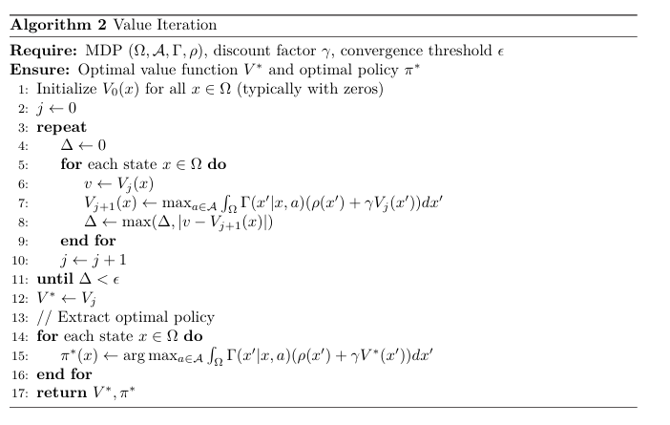
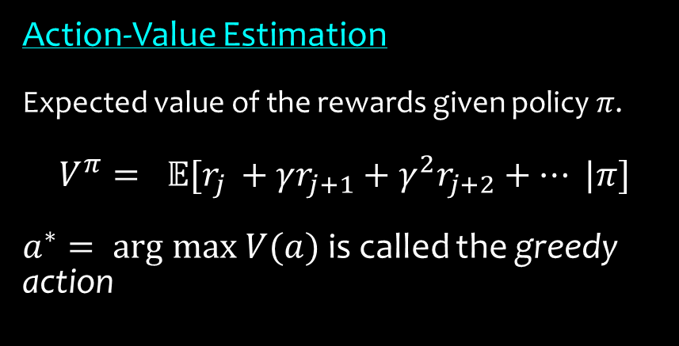
EM Algorithm x Value Iteration
Action-Value Estimation Algorithm
At each iteration, select the action corresponding to highest estimated value
Select new point, compute how “off” our value estimate was for that action
Update Value function estimator so that it predicts something a little closer to what we actually observed (i.e. fix our model so we are less “surprised” by the data)
Action-Value Estimation
Expected value of the rewards given policy $π$.
$$V^{π}= 𝔼[r_{j }+γr_{j+1}+γ^{2}r_{j+2}+… |π]$$
$a^{∗}= \text{arg} \text{max} V(a)$ is called the greedy action
Taking into account predicted future rewards
Choose treatment $a_{j}$ next!
Action $a_{j}$
1
2
3
Reward $r_{j}$
Environment

Slide 13
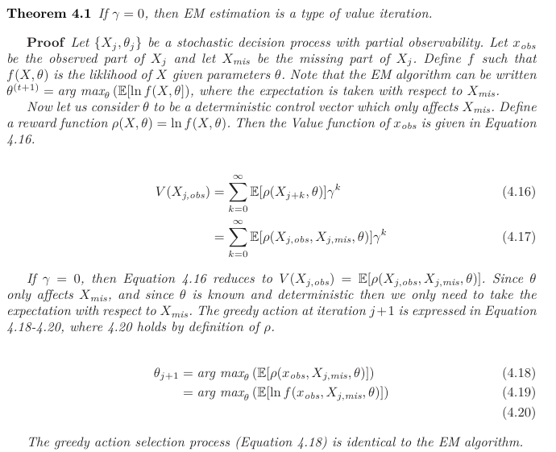
EM Algorithm x Value Iteration
The EM algorithm arises from Value Iteration if we set $γ=0$

Slide 14
Connection between CI and RL is not widely known
“One of the most dramatic moments in science is when two great fields suddenly come together and are unified”
- Richard Feynmann
Research is siloed into institutional departments.
Graduate students are discouraged from taking classes out side of their department , since funding allocation is competitive between departments.
Journals are highly specialized. It is increasingly difficult to publish translational research.

Slide 15
Other Connections That Are Not Widely Known
Concepts
Citations
The Kalman filter, commonly used in engineering control, is a Value iteration procedure with additional assumptions
Inverse Probability of Treatment Weights mathematically arise from Importance Sampling methods
Marginal Structural Modelling, TD-learning, and Attention Mechanisms share structural similarities and mathematical synergies
Lange, Rutger Jan. Bellman filtering for state-space models. No. TI 2020-052/III. Tinbergen Institute Discussion Paper, 2021.
Jiang, Nan, and Lihong Li. "Doubly robust off-policy value evaluation for reinforcement learning." In International conference on machine learning, pp. 652-661. PMLR, 2016.
MaryLena Bleile. Optimal Control Using Causal Agents. CRC Press, Boca Raton FL. Forthcoming 2027

Slide 16
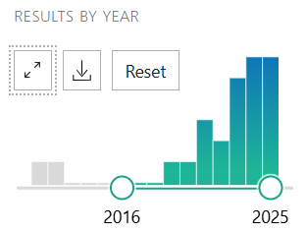

Connection between CI and RL is not widely known
…but Causal Reinforcement Learning Research is gaining traction
Number of co-appearances of “Causal Inference” and “Reinforcement Learning” is growing
Growing understanding of how causal methods can augment Reinforcement Learning
www.MaryLenaBleile.com
marylenableile@gmail.com
Connect with me on LinkedIn!

Slide 17
Bonus: Richard Bellman
The subject of point set topology has always bored me…. I have never liked to go to class.
Consequently, I dropped out of [Topology] after a few weeks.
[The professor] was quite disturbed by that and asked me what I would offer for
qualifying, I replied that God would provide.
When I took my qualifying exams, Lefschetz, Tukey, and Shiffman
were the examiners. Lefschetz asked me some questions about real
variables, and Shiffman double-crossed me.
Bellman
optimality equations
“I had sat in on Shiffman's course, calculus of variations in the large and we had agreed he would
ask me some questions about the material he had covered in the first
few weeks. Instead, I spent a very uncomfortable hour. Whenever
Tukey and Shiffman saw that I knew the answer to a question, they
stopped me. They only persisted if they saw I didn't know the answer.
When it was over, Lefschetz took me aside and said, "You didn't do
very well." I merely snarled.
“
Tukey
Tukey

